Slide 1
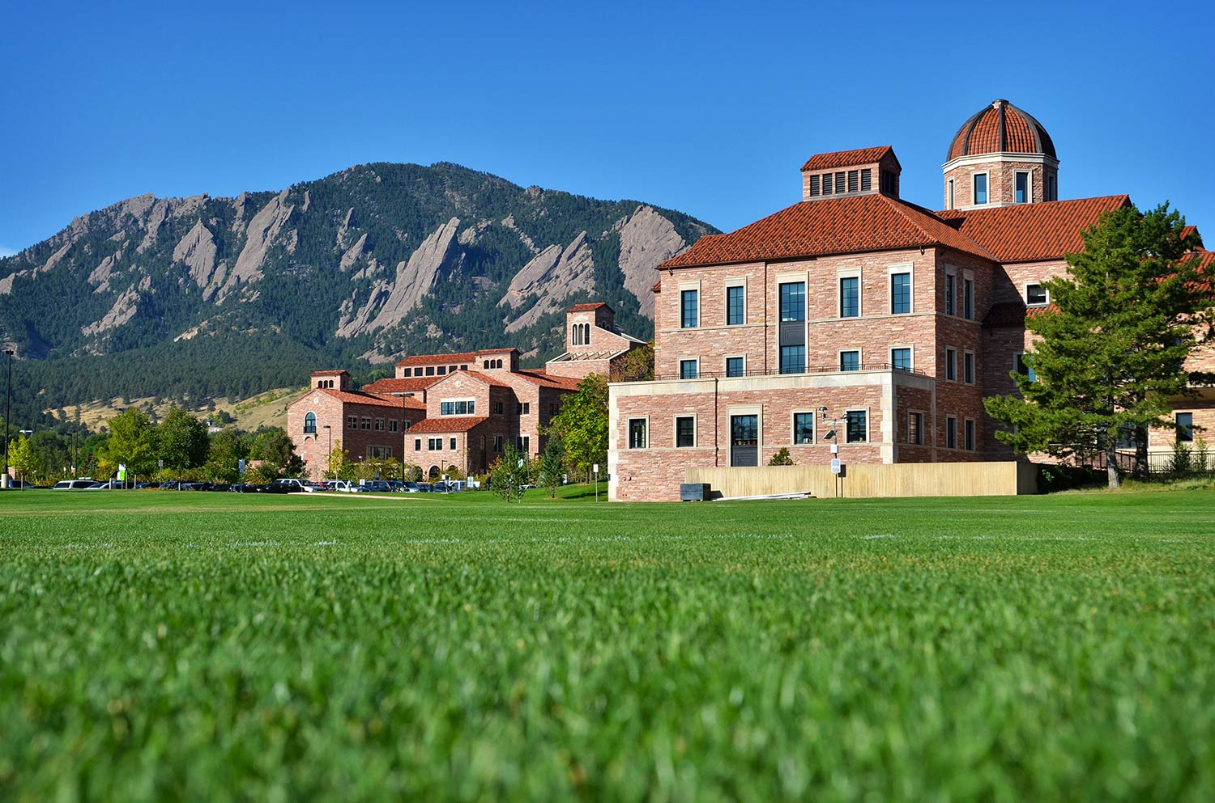
Non-Current Liabilities Part 1 - Video

Slide 2
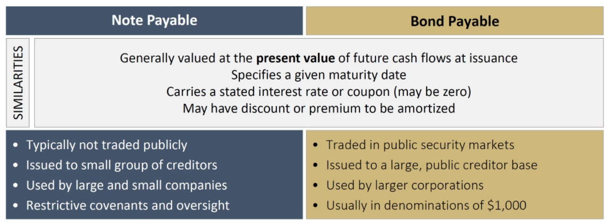
Non-Current Liabilities
Non-current (or long-term) liabilities are obligations due in more than one year.

Slide 3
Note Payable
Formal financing agreement with interest
Written promissory note that specifies amount(s) and timing of cash receipts
Can be issued to borrow cash or for specific asset acquisitions (e.g., PP&E)
Measure carrying value (book value) at PV of cash flows discounted by market rate unless note is issued for asset and fair value is known.

Slide 4
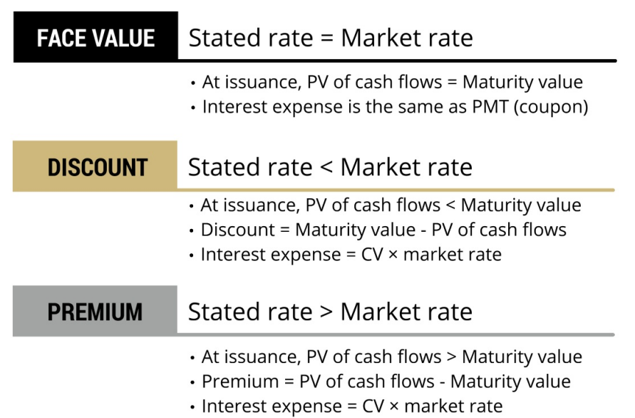
Review of Discount/Premium

Slide 5
Example 1
On January 1, 2020, Philippe Inc. issued a three-year, $50,000 note to Maurice Banking, with a stated interest of 8% to be paid annually on December 31. The prevailing market rate is 8%.
(a) Record the journal entry for the note issuance.
1/1/2020 Cash (B-A) 50,000
Note Payable (B-L) 50,000

Slide 6
Example 1
On January 1, 2020, Philippe Inc. issued a three-year, $50,000 note to Maurice Banking, with a stated interest of 8% to be paid annually on December 31. The prevailing market rate is 8%.
(b) Record the interest expense journal entry on Dec. 31, 2020
12/31/2020 Interest Exp. (I-E) 4,000
Cash (B-A) 4,000

Slide 7
Example 1
On January 1, 2020, Philippe Inc. issued a three-year, $50,000 note to Maurice Banking, with a stated interest of 8% to be paid annually on December 31. The prevailing market rate is 8%.
(c) Record the repayment of principal on Dec. 31, 2022
12/31/2022 Note Payable (B-L) 50,000
Cash (B-A) 50,000

Slide 8
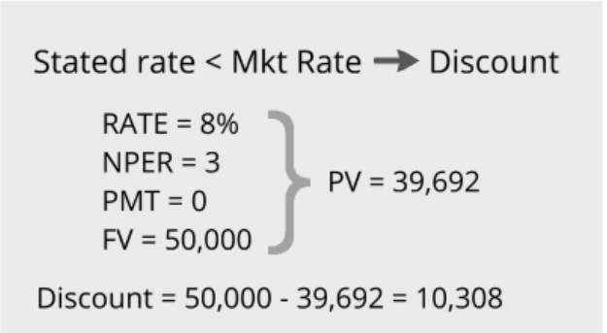
Example 2
On January 1, 2020, Philippe Inc. issued a three-year, $50,000 zero-interest bearing note to Maurice Banking. The prevailing market rate is 8%.
(a) Record the journal entry for the note issuance.
1/1/2020 Cash (B-A) 39,692
Discount on N/P (B-XL) 10,308
Note Payable (B-L) 50,000

Slide 9
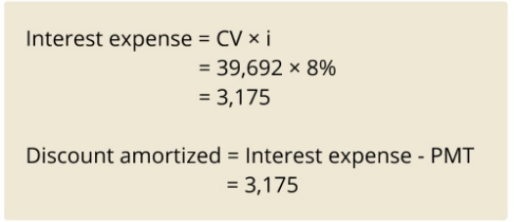
Example 2
On January 1, 2020, Philippe Inc. issued a three-year, $50,000 zero-interest bearing note to Maurice Banking. The prevailing market rate is 8%.
(b) Record the interest expense journal entry on Dec. 31, 2020
12/31/2020 Interest Exp. (I-E) 3,175
Discount on N/P (B-XL) 3,175

Slide 10
Example 2
On January 1, 2020, Philippe Inc. issued a three-year, $50,000 zero-interest bearing note to Maurice Banking. The prevailing market rate is 8%.
(c) Record the repayment of principal on Dec. 31, 2022
12/31/2022 Note Payable (B-L) 50,000
Cash (B-A) 50,000

Slide 11
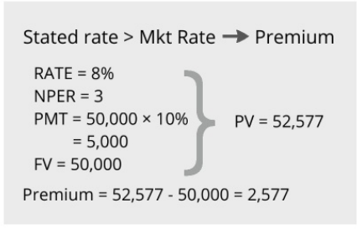
Example 3
On January 1, 2020, Philippe Inc. issued a three-year, $50,000 note to Maurice Banking, with a stated interest of 10% to be paid annually on December 31. The prevailing market rate is 8%.
(a) Record the journal entry for the note issuance.
1/1/2020 Cash (B-A) 52,577
Premium on N/P (B-L) 2,577
Note Payable (B-L) 50,000

Slide 12
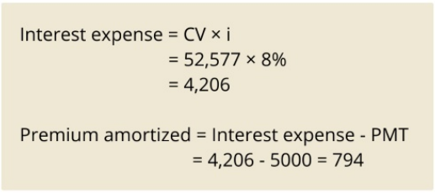
Example 3
On January 1, 2020, Philippe Inc. issued a three-year, $50,000 note to Maurice Banking, with a stated interest of 10% to be paid annually on December 31. The prevailing market rate is 8%.
(b) Record the interest expense journal entry on Dec. 31, 2020
12/31/2020 Interest Exp. (I-E) 4,206
Premium on N/P (B-L) 794
Cash (B-A) 5,000

Slide 13
Example 3
On January 1, 2020, Philippe Inc. issued a three-year, $50,000 note to Maurice Banking, with a stated interest of 10% to be paid annually on December 31. The prevailing market rate is 8%.
(c) Record the repayment of principal on Dec. 31, 2022
12/31/2022 Note Payable (B-L) 50,000
Cash (B-A) 50,000

Slide 14
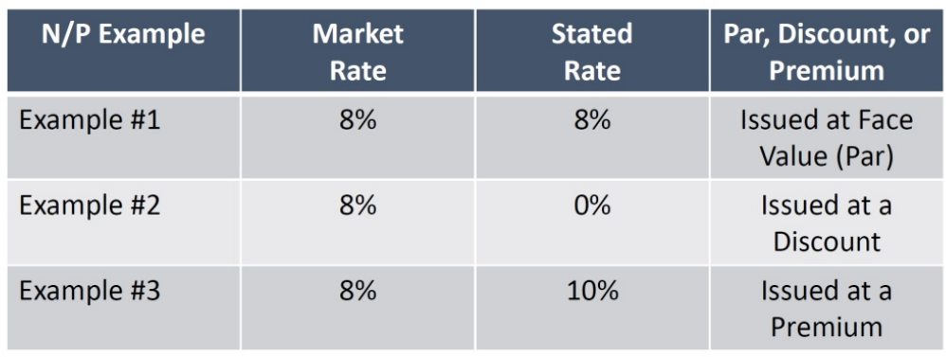
Summary of Examples

Slide 15
Notes Payable Issued for Non-Cash Consideration
Instead of receiving cash, note is exchanged for a non-cash item (goods or services)
At issuance, measure carrying value (book value) of N/P at:
First choice: fair value of non-cash item
Otherwise, PV of future cash flows
Record asset received at carrying value of note payable

Slide 16
Closing Thoughts
Bond payables and note payables are measured at present value of future cash flows at issuance.
Notes issued for non-cash items (like PP&E) are measured at fair value of item (or PV of future cash flows if fair value unknown)
Notes and bonds can be issued at pay, premium, or discount.

Slide 17
Non-Current Liabilities Part 1 - Video

